Slide 1
Module 4
Electronic Mail Security
PGP
S/MIME
IP security

Slide 2
Electronic Mail Security
Email is one of the most widely used and regarded network services
Currently message contents are not secure
may be inspected either in transit
or by suitably privileged users on destination system

Slide 3
Email Security Enhancements
Confidentiality
protection from disclosure
Authentication
of sender of message
Message integrity
protection from modification
Non-repudiation of origin
protection from denial by sender

Slide 4
Email Security
There are two main schemes which are especially designed to provide confidentiality and authentication for electronic mail systems.
These are:
1 Pretty good privacy (PGP)
2 Secure/Multipurpose Internet Mail Extension (S/MIME)

Slide 5
Pretty Good Privacy (PGP)
Developed by Phil Zimmerman
Documentation and source code is freely available.
The package is independent of operating system and processor.

Slide 6
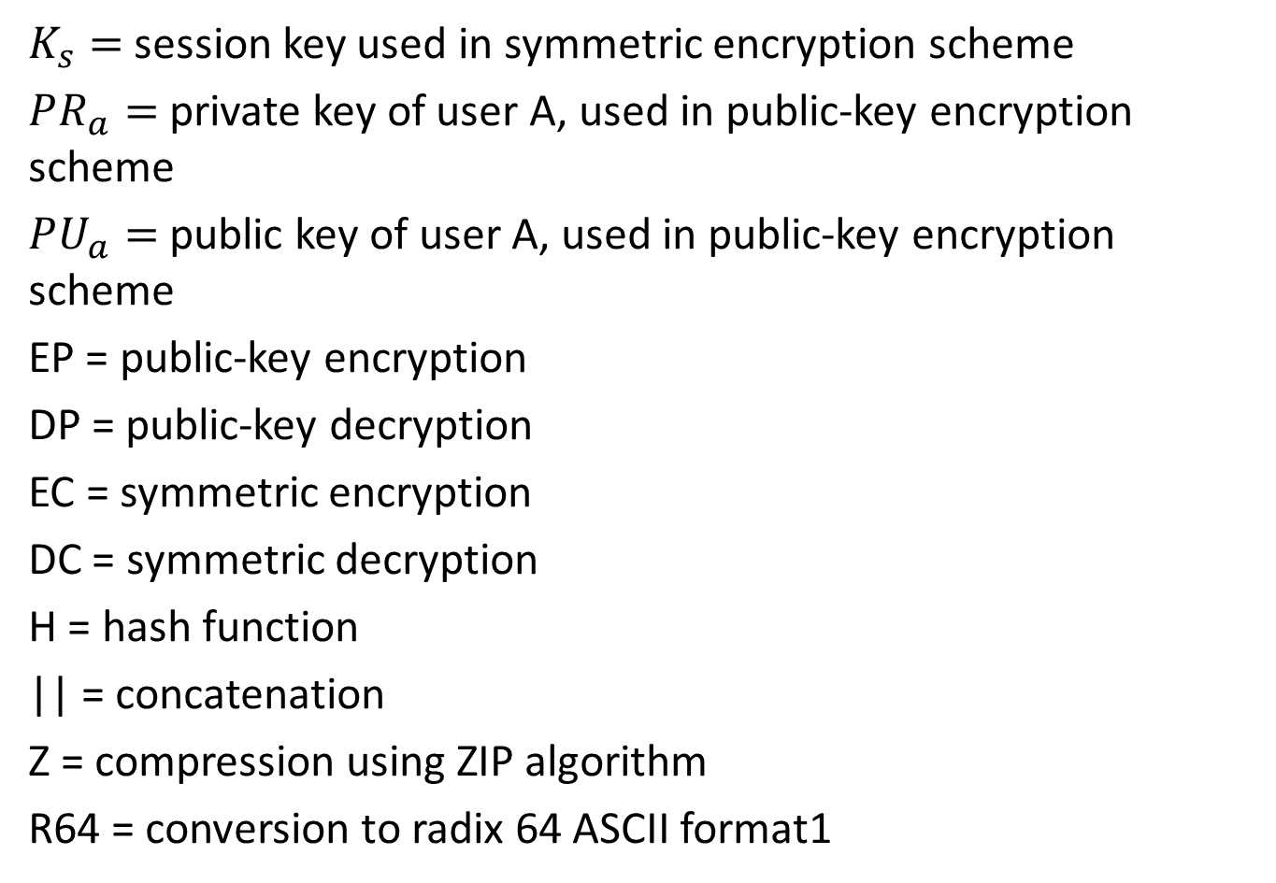
PGP Notation
$K_{s}=$session key used in symmetric encryption scheme
$PR_{a}=$private key of user A, used in public-key encryption scheme
$PU_{a}=$public key of user A, used in public-key encryption scheme
EP = public-key encryption
DP = public-key decryption
EC = symmetric encryption
DC = symmetric decryption
H = hash function
|| = concatenation
Z = compression using ZIP algorithm
R64 = conversion to radix 64 ASCII format1

Slide 7
PGP
PGP offers 5 services:
Authentication – Digital signature
Confidentiality - Symmetric block encryption
Compression - ZIP – algorithm
E-mail compatibility - Radix 64 encoding scheme
Segmentation & Reassembly

Slide 8
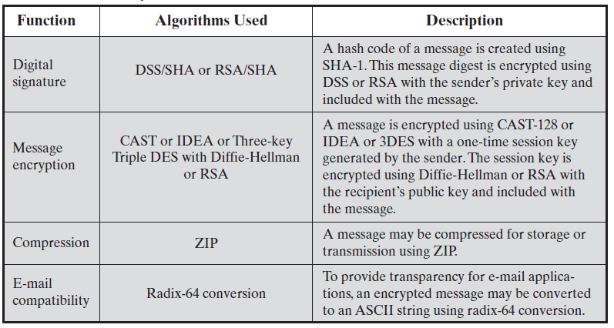
Summary of PGP Services

Slide 9
PGP - Authentication
Digital signature service provided by PGP
Sender creates message
Use SHA-1 to generate 160-bit hash of message
Signed hash with RSA using sender's private key, and is attached to message
Receiver uses RSA with sender's public key to decrypt and recover hash code
Receiver verifies received message using hash of it and compares with decrypted hash code

Slide 10
PGP – Confidentiality
Achieved by encrypting the message
Main steps here are
Sender generates message and 128-bit random number as session key for it
Encrypt message using CAST-128 / IDEA / 3DES with session key
Session key encrypted using RSA with recipient's public key and attached to message
Receiver uses RSA with private key to decrypt and recover session key
Session key is used to decrypt message

Slide 11
PGP – Confidentiality & Authentication
Can use both services on same message
Create signature & attach to message
Encrypt both message & signature
Attach RSA/ElGamal encrypted session key
Plaintext message and signature are encrypted by using CAST-128/IDEA/3-DES. And session key encrypted using RSA

Slide 12
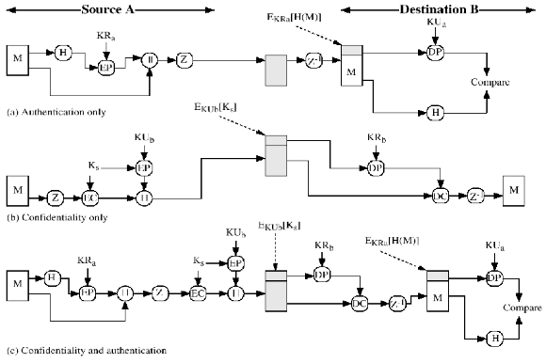
PGP Cryptographic Functions

Slide 13
PGP - Compression
By default PGP compresses message after signing but before encrypting
It stores uncompressed message & signature for later verification
Algorithm is non deterministic
Message encryption applied after compression to strengthen security, compressed message are less redundant than plain text
Uses ZIP compression algorithm

Slide 14
PGP – Email Compatibility
A part of the message is encrypted in PGP
Part of the message consists of a stream of arbitrary 8-bit octets
Many e-mail systems permit only the use of blocks consisting of ASCII text

Slide 15
PGP – Email Compatibility
PGP provides service of converting raw 8-bit binary stream to a stream of printable ASCII characters
Each group of three octets of binary data is mapped into 4 ASCII characters
The scheme used is radix-64 conversion
On receiver side, the incoming block is first converted back to 8-bit octet binary format

Slide 16
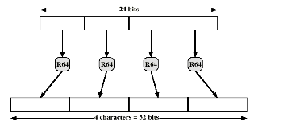
PGP – Email Compatibility
Printable Encoding of binary data into radix-64 format

Slide 17
PGP – Segmentation & Reassembly
E-mail systems often restricted the maximum message length to 50,000 octets
Longer messages must be broken up into smaller segments
Each segment is mailed separately
PGP automatically subdivides a large message into segments
The receiver strips o all e-mail headers and reassemble the block

Slide 18
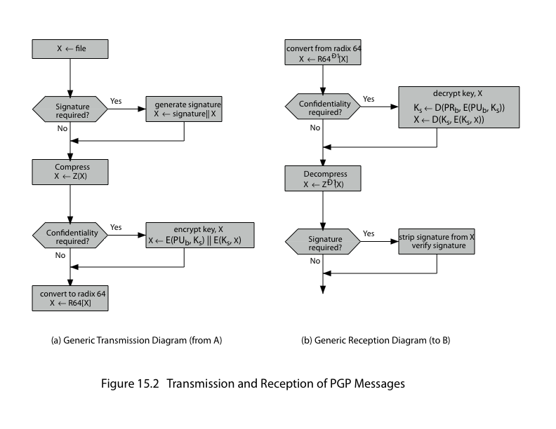
Transmission & Reception of PGP Messages

Slide 19
PGP – Cryptographic Keys
PGP make use of four type of keys :
One time session symmetric key
Public key
Private key
Passphrase based symmetric key

Slide 20
PGP – Session Keys
Each session key is associated with a single message and is used only for the purpose of encrypting and decrypting that message.
Need a session key for each message of varying sizes: 56-bit DES, 128-bit CAST or IDEA, 168-bit Triple-DES
The plaintext input to random number generator consist of two 64-bit blocks, it is derived from stream of 128-bit randomized numbers
Random inputs taken from
-Actual keys hit
-Keystroke timing of a user

Slide 21
PGP Keys Identifiers
Since many public/private keys may be in use, need to identify which is actually used to encrypt session key in a message
Could send full public-key with every message
But this is inefficient
Rather use a key identifier based on key
Is least significant 64-bits of the key
Will very likely be unique
Also use key ID in signatures

Slide 22
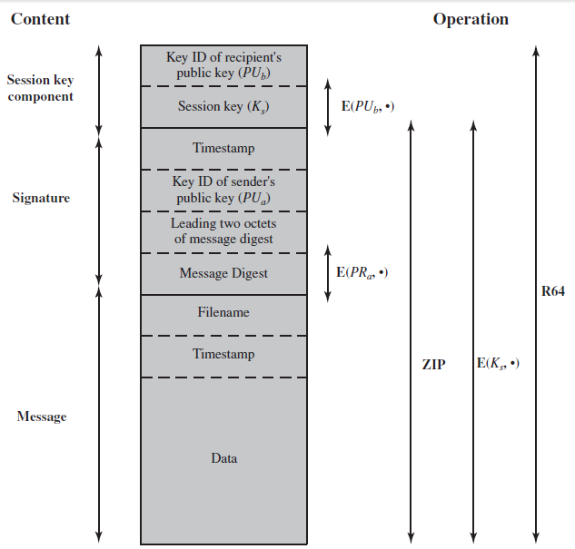
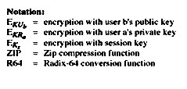
PGP Message Format

Slide 23
PGP Message Components
1. Message component
2. Signature component
Timestamp
Message digest
Leading two octets of message digest
key ID of sender’s public key
3. Session key component

Slide 24
PGP Message Components
Message component → actual data + a filename + a timestamp;
Signature component → timestamp + hash of message and timestamp + first part of message (so user can check that they are decrypting correctly) + Key ID of sender’s public key
Session Key component → session key + key ID of recipient’s public key

Slide 25
PGP Key Rings
2 -key ID’s are used in any PGP message that provides Authentication & Confidentiality
These keys needs to be stored and organized in a systematic way for efficient & efficient use by all parties
PGP provides a pair of data structures at each node :-
1-to store public/private key pairs owned by that node
1-to store public keys of other users known at this node

Slide 26
PGP Key Rings
Each PGP user has a pair of keyrings:
Public-key ring : contains all the public-keys of other PGP users known to this user, indexed by key ID
Private-key ring : contains the public/private key pair(s) for this user, indexed by key ID & encrypted key from a hashed passphrase
Security of private keys thus depends on the pass-phrase security

Slide 27
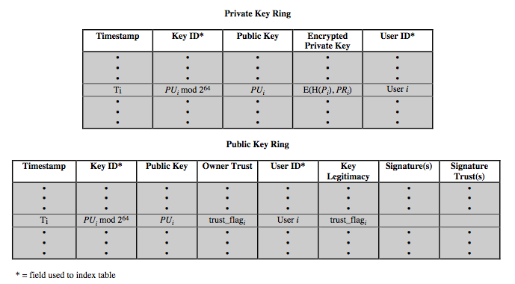
PGP Key Rings

Slide 28
Private Key Ring
Each row of the table represents one public/private key pair owned by the user.
Timestamp: the date/time when this key pair was generated.
Key Id: The least significant 64 bits of the public key (for this entry).

Slide 29
Private Key Ring
Public key: public key portion of the pair in this row.
Private key: Encrypted private key for this pair.
User Id: User may have a different name with each pair. (may use the same id more than once.)
Private key should be securely stored.
ie, private key is not stored directly in private key ring.
Private key encypted using CAST- 128 & then stored in key ring.

Slide 30
Private Key Ring
CAST – 128 procedure
1. Users selects a password to be used for encrypting private keys.
2. When system generates a new public/private key pair, it asks the user for a passphrase.
3. Using SHA-1, a 160 bit hash code is generated from the password. //password is discarded//
4. System encrypts the private key using 128 bits of the hash as the key. //hash code is then discarded//
5. Encrypted private key stored in ring.

Slide 31
Private Key Ring
Accessing a private key:
> User must supply the passphrase(password).
> PGP will retrieve encrypted private key
> PGP generates the hash code of passphrase.
> Decrypts the encrypted private key using CAST-128 (with the hash code)
>>Security depends upon the security of the password.

Slide 32
Public Key Ring
Stores the public keys of other users known to this user.
User Id : Owner of this key. (A key may have multiple owners.)
Timestamp: date/time at which this entry was generated.
Key ID: The least significant 64 bits of the public key (for this entry).
Public key: public key for this entry.

Slide 33
Steps Performed by Sending PGP Entity
1. Signing the Message.
PGP retrieves the senders private key from the private key ring using your’_user ID as an index
PGP asks the user for the passphrase, to recover the unencrypted private key
Signature component of the message is then constructed

Slide 34
Steps Performed by Sending PGP Entity
2. Encrypting the Message :
PGP generates a session key & encrypts the message
PGP retrieves the recipients public key from the public key ring using her_ userID as an index
The session key component of the message is then constructed

Slide 35
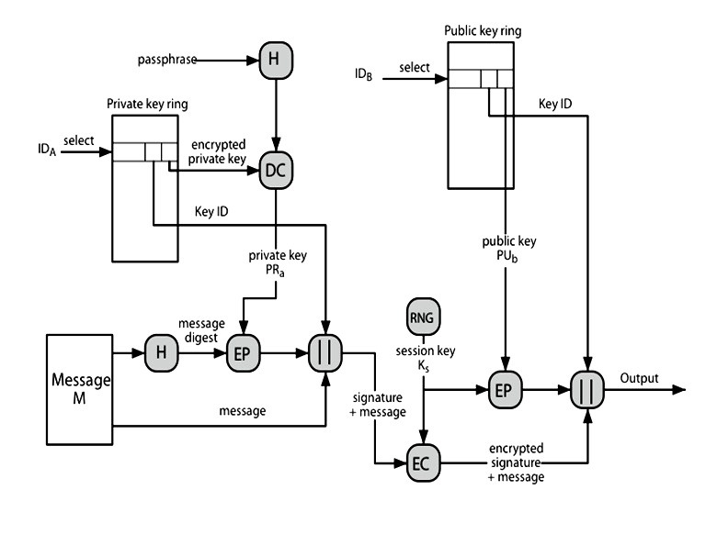
PGP Message Generation

Slide 36
Steps Performed by Receiving PGP Entity
1. Decrypting The Message :
PGP retrieves receivers private key from the private key ring using the key ID field in the session key component.
PGP asks the user for the passphrase to recover unencrypted private key.
PGP then recovers the session key & decrypts the message.

Slide 37
Steps Performed by Receiving PGP Entity
2. Authenticating the Message :
PGP retrieves senders public key from public key ring using the keyID field in the signature key component of the message as an index.
PGP recovers the transmitted message digest.
PGP computes the message digest for the received message & compares it to the transmitted message digests to authenticate.

Slide 38
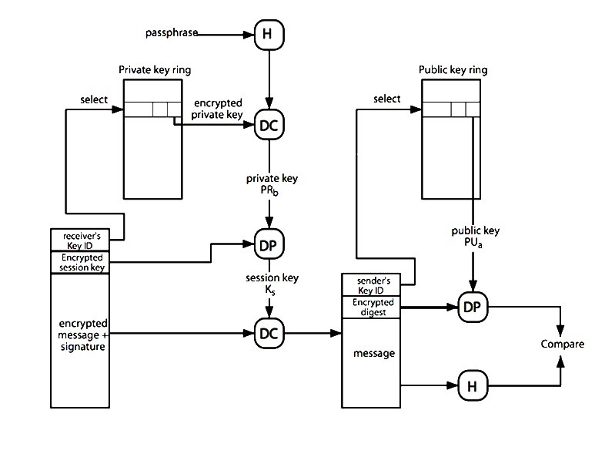
PGP Message Reception

Slide 39
Public Key Management for PGP
Public keys for encrypting session keys / verifying signatures.
Private keys for decrypting session keys / creating signatures.

Slide 40
Public Key Management for PGP
PGP adopts a trust model called the web of trust.
No centralised authority
Individuals sign one another’s public keys, these “certificates” are stored along with keys in key rings.
PGP computes a ‘trust level’ for each public key in key ring.
Users interpret trust level for themselves

Slide 41
Public Key Management for PGP
Trust levels for public keys dependent on:
Number of signatures on the key;
Trust level assigned to each of those signatures.
Trust levels recomputed from time to time

Slide 42
Approaches to Public-Key Management
A wishes to obtain a reliable public key for B
Physically get the key from B.
Verify a key by telephone.
Obtain B's public key from a mutual trusted individual D.
Obtain B's public key from a trusted certifying authority.

Slide 43
Use of Trust
PGP uses trust, associates trust with public keys, and exploits trust info.
Public-key ring has three fields:
Key legitimacy field
Signature trust field
Owner trust field

Slide 44
Use of Trust
Key legitimacy field:
Indicates the extent to which PGP will trust that this is a valid public key of this user.
The higher the level of trust, the stronger is the binding of this user ID to this key.
This field is computed by PGP.
An entry in the table may have zero/more signatures that signed this certificate.

Slide 45
Use of Trust
Signature trust field:
Indicates the degree to which this user trusts the signer to certify public keys.
Key legitimacy field is derived from the collection of signature trust fields.

Slide 46
Use of Trust
Owner trust field:
Indicates the degree to which this public key is trusted to sign other public key certificates.
This Level of trust is assigned by the user.

Slide 47
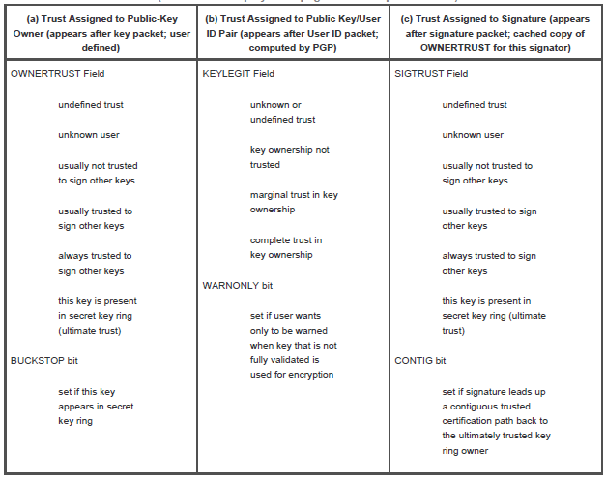
Use of Trust
The three fields mentioned in the previous paragraph are each contained in a structure referred to as a trust flag byte.

Slide 48
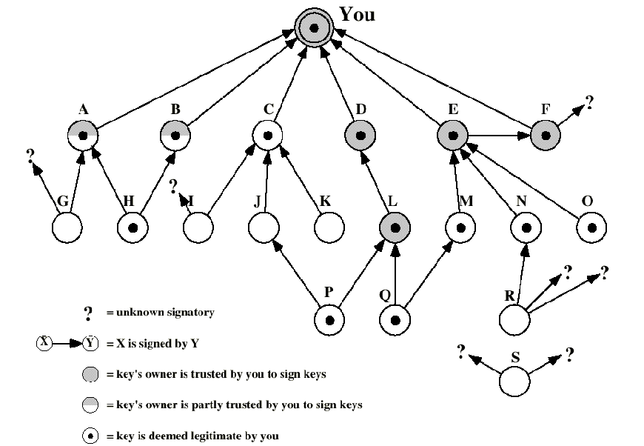
PGP Trust Model Example

Slide 49
Use of Trust
The user has acquired several public-keys:
Some directly from their owners.
Some from a third party (key server).
YOU refers to entry in the ring corresponding to this user.
”Owner trust” value is highest for it.

Slide 50
Use of Trust
Users D,E,F, and L are always trusted to sign other keys.
Users A and B are partially trusted to sign other keys.
Tree structure indicates which key has been signed by what user.
Arrow: signer’s key is present in ring.
Arrow?: signer’s key is not present.

Slide 51
Use of Trust
All keys whose owners are fully or partially trusted by this user have been signed by this user, with the exception of node L.
Two partially trusted signatures are sufficient to certify a key.
A key may be determined to be legitimate because it is signed by one fully trusted or two partially trusted signatories, but its user may not be trusted to sign other keys.
Detached "orphan" node S, with two unknown signatures. Such a key may have been acquired from a key server.

Slide 52
Use of Trust
A public key has a number of user IDs associating with it, with a number of signatures below each user ID.
The binding of a particular user ID to a key depends on the signatures associated with that user ID and that key, whereas the level of trust in this key is a function of all the dependent signatures.

Slide 53
Revoking Public Keys
A user might like to revoke his current public key due to any reason.
Key Revocation procedure:
The owner issue a key revocation certificate. (signed by the owner)
Corresponding private key is used to sign the certificate.

Slide 54
S/MIME Route map
When email was first developed, people could only send plain text messagesRFC822 , 5322
MIME was developed in early 90s to allow people to send pictures, sound, programs and general attachments --“Multipurpose Internet Mail Extension” RFC 2045-20459
MIME has no security features, can be read along its route or forged (easily)
S/MIME is a secure version of MIME RFC 2630, 2632, 2633

Slide 55
What is S/MIME?
Secure / Multipurpose Internet Mail Extension
A security enhancement to MIME
Provides similar services to PGP
Based on technology from RSA Security
Industry standard for commercial and organizational use

Slide 56
What does S/MIME give us?
Secrecy–Only intended recipient can read the message. (A thick envelope and trustworthy couriers.)
Authentication–Recipient knows the message came from the apparent sender. (An ink signature that you recognize.)
Integrity–Recipient knows the message was not changed en route. (Un-erasable ink in a letter.)

Slide 57
RFC 822
Defines a format for text messages to be sent using e-mail
Internet standard
Structure of RFC 822 compliant messages
–header lines (e.g., from: …, to: …, cc: …)
–blank line
–body (the text to be sent)

Slide 58
Problems with RFC 822,5322
Executable files must be converted into ASCII
–various schemes exist (e.g., Unix UUencode)
–a standard is needed
Text data that includes special characters (e.g., Hungarian text)
Some SMTP servers
–reject messages over a certain size
–delete, add, or reorder CR and LF characters
–truncate or wrap lines longer than 76 characters
–remove trailing white space (tabs and spaces)
–pad lines in a message to the same length
–convert tab characters into multiple spaces

Slide 59
MIME
Defines new message header fields
Defines a number of content formats (standardizing representation of multimedia contents)
Defines transfer encodings that protects the content from alteration by the mail system

Slide 60
MIME -New header fields
MIME-Version
Content-Type
–describes the data contained in the body
–receiving agent can pick an appropriate method to represent the content
Content-Transfer-Encoding
–indicates the type of the transformation that has been used to represent the body of the message
Content-ID
Content-Description
–description of the object in the body of the message
–useful when content is not readable (e.g., audio data)

Slide 61
MIME –Content types and subtypes
text/plain, text/enriched
image/jpeg, image/gif
video/mpeg
audio/basic
application/postscript, application/octet-stream
multipart/mixed, multipart/parallel, multipart/alternative, multipart/digest (each part is message/rfc822)
message/rfc822, message/partial, message/external-body

Slide 62
MIME –Transfer encodings
7bit
–short lines of ASCII characters
8bit
–short lines of non-ASCII characters
Binary
–non-ASCII characters
–lines are not necessarily short
quoted-printable
–non-ASCII characters are converted into hexa numbers (e.g., =EF)
base64 (radix 64)
–Commonly used for encoding arbiter binary data securely
–(used in PGP and S/MIME)
x-token
–non-standard encoding

Slide 63
S/MIME Functionality
Enveloped data (application/pkcs7-mime; smime-type = enveloped-data)
–standard digital envelop
Signed data (application/pkcs7-mime; smime-type = signed-data)
–standard digital signature (“hash and sign”)
–content + signature is encoded using base64 encoding
Clear-signed data (multipart/signed)
–standard digital signature
–only the signature is encoded using base64
–recipient without S/MIME capability can read the message but cannot verify the signature
Signed and enveloped data
–signed and encrypted entities may be nested in any order

Slide 64
S/MIME Cryptographic Algorithms
Must: The definition is an absolute requirement of the specification.
Should: There may exist valid reasons in particular circumstances to ignore this feature or function.

Slide 65
S/MIME Cryptographic Algorithms
Message digest
–must: SHA-1
–should (receiver): MD5 (backward compatibility)
Digital signature
–must: DSS
–should: RSA
Asymmetric-key encryption
–must: ElGamal
–should: RSA
Symmetric-key encryption
–sender: should: 3DES, RC2/40
–receiver:
must: 3DES
should: RC2/40

Slide 66
S/MIME Messages
S/MIME makes use of a number of new MIME content types.
All of the new application types use the designation PKCS. This refers to a set of public-key cryptography specifications

Slide 67
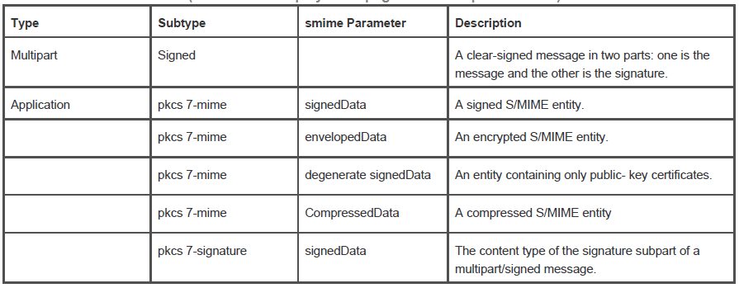
S/MIME Content Types

Slide 68
Securing a MIME entity
MIME entity is prepared according to the normal rules for MIME message preparation.
Prepared MIME entity and some security related data are processed by S/MIME to produce a PKCS object.
The PKCS object is treated as message content and wrapped in MIME

Slide 69
Enveloped Data
The steps for preparing an envelopedData MIME entity are as follows:
Generate a pseudorandom session key for a particular symmetric encryption algorithm (RC2/40 or tripleDES).
For each recipient, encrypt the session key with the recipient's public RSA key.
For each recipient, prepare a block known as RecipientInfo that contains an identifier of the recipient's public-key certificate,an identifier of the algorithm used to encrypt the session key, and the encrypted session key.
Encrypt the message content with the session key.

Slide 70
SignedData
The steps for preparing a signedData MIME entity are as follows:
Select a message digest algorithm (SHA or MD5).
Compute the message digest, or hash function, of the content to be signed.
Encrypt the message digest with the signer's private key.
Prepare a block known as SignerInfo that contains the signer's public-key certificate, an identifier of the message digest algorithm, an identifier of the algorithm used to encrypt the message digest, and the encrypted message digest.

Slide 71
Clear Signing
Clear signing is achieved using the multipart content type with a signed subtype.
This signing process does not involve transforming the message to be signed, so that the message is sent "in the clear."
A multipart/signed message has two parts.
The first part can be any MIME type but must be prepared so that it will not be altered during transfer from source to destination.
This second part has a MIME content type of application and a subtype of pkcs7-signature.

Slide 72
Registration Request
The application/pkcs10 S/MIME entity is used to transfer a certification request.
The certification request includes certificationRequestInfo block, followed by an identifier of the public-key encryption algorithm, followed by the signature of the certificationRequestInfo block, made using the sender's private key.
The certificationRequestInfo block includes a name of the certificate subject (the entity whose public key is to be certified) and a bit-string representation of the user's public key.

Slide 73
Certificates-Only Message
A message containing only certificates or a certificate revocation list (CRL) can be sent in response to a registration request.

Slide 74
S/MIME Certificate Processing
S/MIME uses public-key certificates that conform to version 3 of X.509.
The certificates are signed by certification authorities.

Slide 75
User Agent Role
An S/MIME user has several key-management functions to perform:
Key generation
Registration
Certificate storage and retrieval

Slide 76
VeriSign Certificates
There are several companies that provide certification authority (CA) services.
There are a number of Internet-based CAs, including VeriSign, GTE, and the U.S. Postal Service.
The information contained in a Digital ID depends on the type of Digital ID and its use.
At a minimum, each Digital ID contains
Owner's public key
Owner's name or alias
Expiration date of the Digital ID
Serial number of the Digital ID
Name of the certification authority that issued the Digital ID
Digital signature of the certification authority that issued the Digital ID
Digital IDs can also contain other user-supplied information, including
Address
E-mail address
Basic registration information (country, zip code, age, and gender)

Slide 77
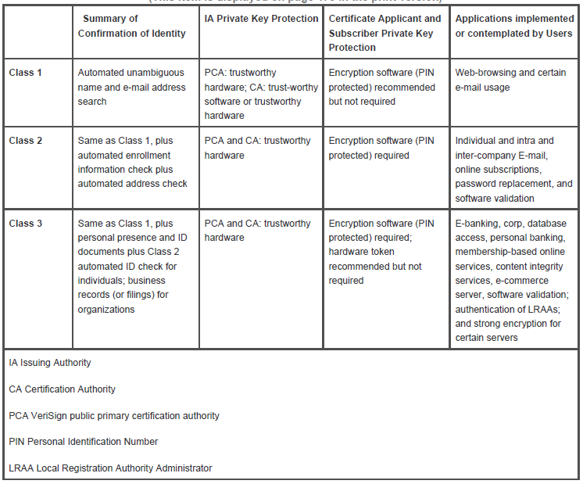
VeriSign Public-Key Certificate Classes

Slide 78
Enhanced Security Services
Signed receipts
Security labels
Secure mailing lists

Slide 79
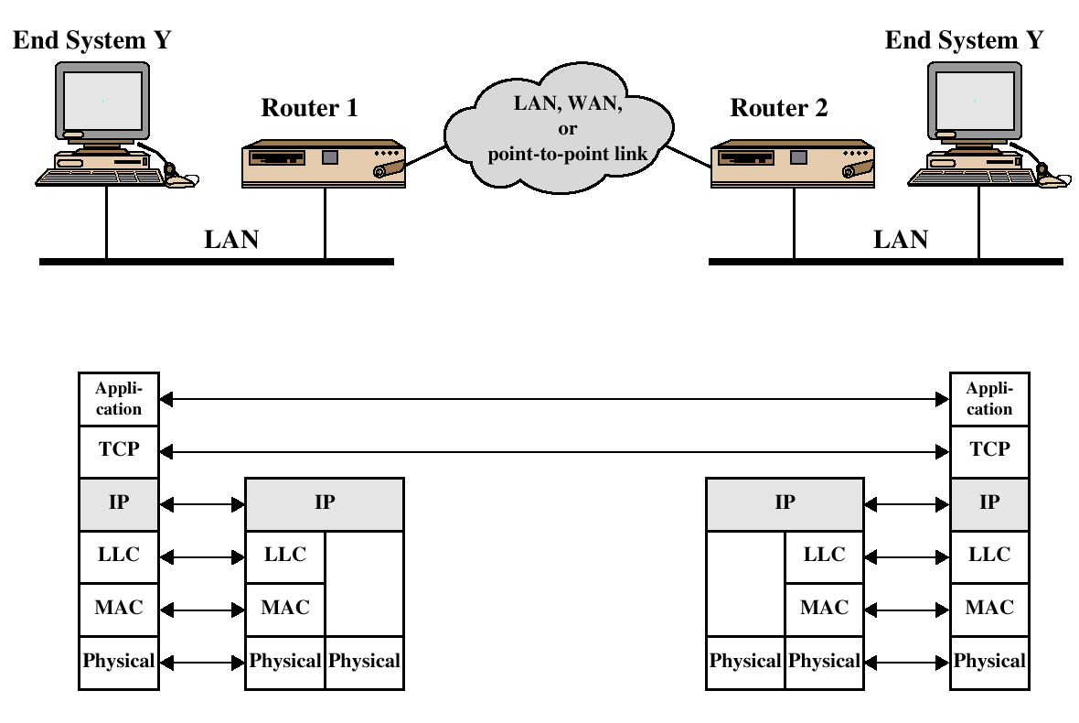
TCP/IP Example

Slide 80
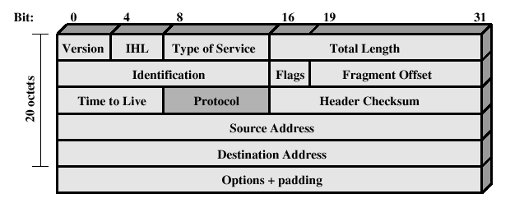
IPv4 Header

Slide 81
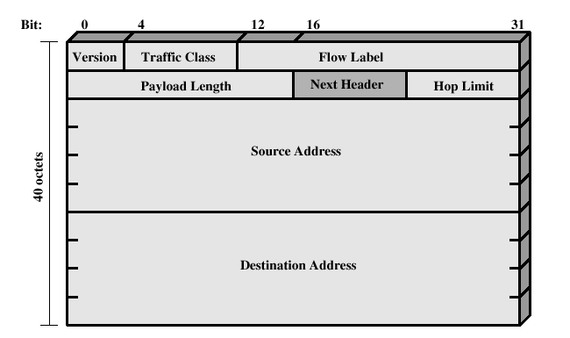
IPv6 Header

Slide 82
IP Security Overview
IP Security (IPsec) is not a single protocol.
IPsec is a capability that can be added to either current version of the Internet Protocol (IPv4 or IPv6) by means of additional headers.
IPsec encompasses three functional areas: authentication, confidentiality and key management.

Slide 83
IP Security Overview
Applications of IPSec
Secure branch office connectivity over the Internet
Secure remote access over the Internet
Establsihing extranet and intranet connectivity with partners
Enhancing electronic commerce security

Slide 84
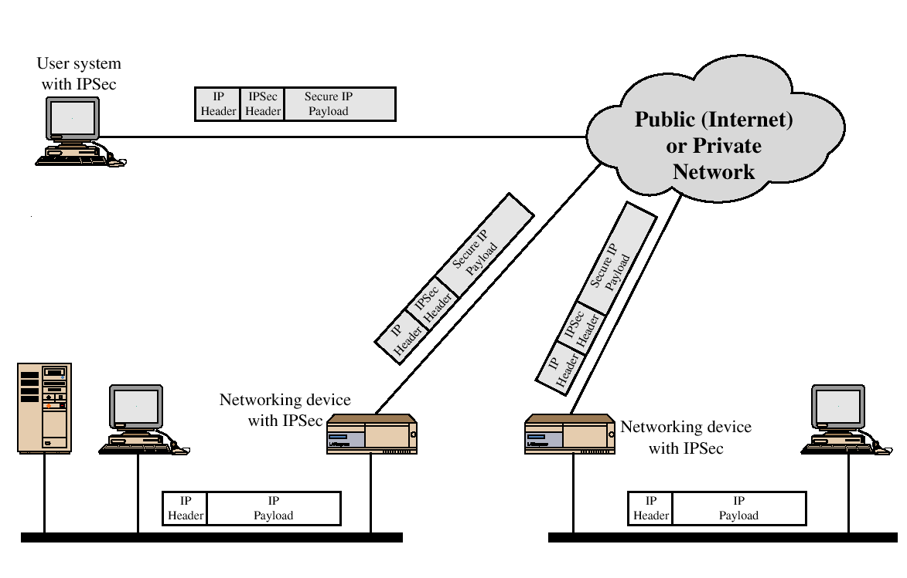
An IP Security Scenario

Slide 85
IP Security Overview
Benefits of IPsec
When IPsec is implemented in a firewall or router, it provides strong security that can be applied to all traffic crossing the perimeter.
IPsec is below the transport layer (TCP, UDP) and so is transparent to applications.
IPsec can be transparent to end users.
IPsec can provide security for individual users if needed.

Slide 86
IP Security Overview
Routing Applications
A router advertisement comes from an authorized router.
A neighbor advertisement comes from an authorized router.
A redirect message comes from the router to which the initial IP packet was sent.
A routing update is not forged.

Slide 87
IP Security Architecture
IPsec Documents
IPsec Services
Security Associations
Transport & Tunnel Modes

Slide 88
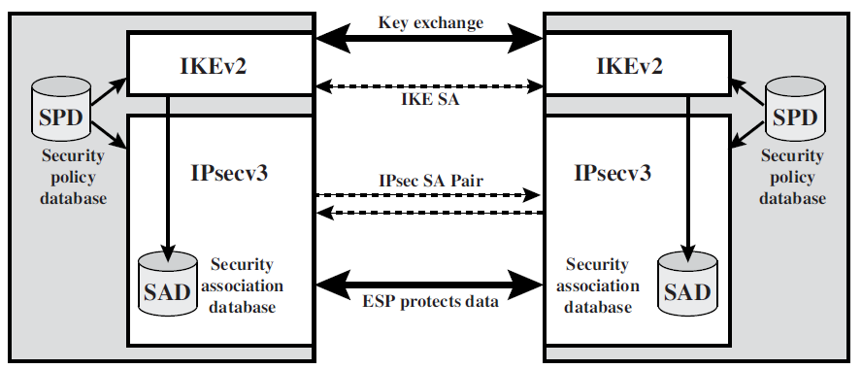
IP Security Architecture

Slide 89
IPsec Documents
The documents can be categorized into the following groups.
Architecture:
Covers the general concepts, security requirements, definitions, and mechanisms defining IPsec technology.
The current specification is RFC 4301
Authentication Header (AH):
AH is an extension header to provide message authentication.
The current specification is RFC 4302
Encapsulating Security Payload (ESP):
ESP consists of an encapsulating header and trailer used to provide encryption or combined encryption/authentication.
The current specification is RFC 4303
Internet Key Exchange (IKE):
This is a collection of documents describing the key management schemes for use with IPsec. The main specification is RFC 4306
Cryptographic algorithms:
This category encompasses a large set of documents that define and describe cryptographic algorithms for encryption, message authentication, pseudorandom functions (PRFs), and cryptographic key exchange.
Domain of Interpretation (DOI):
There are a variety of other IPsec-related RFCs, including those dealing with security policy and management information base (MIB) content.

Slide 90
IPsec Services
Access control
Connectionless integrity
Data origin authentication
Rejection of replayed packets (a form of partial sequence integrity)
Confidentiality (encryption)
Limited traffic flow confidentiality

Slide 91
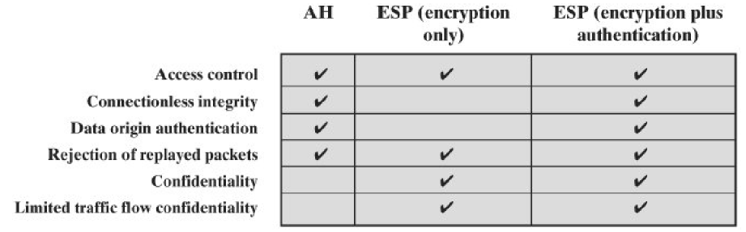
IPsec Services

Slide 92
Security Associations
An association is a one-way relationship between a sender and a receiver that affords security services to the traffic carried on it.
If a peer relationship is needed, for two-way secure exchange, then two security associations are required.
Security services are afforded to an SA for the use of AH or ESP, but not both.

Slide 93
Security Associations
A security association is uniquely identified by three parameters:
Security Parameters Index (SPI):
The SPI is carried in AH and ESP headers to enable the receiving system to select the SA under which a received packet will be processed.
IP Destination Address:
Currently, only unicast addresses are allowed; this is the address of the destination endpoint of the SA, which may be an end user system or a network system such as a firewall or router.
Security Protocol Identifier:
This indicates whether the association is an AH or ESP security association.

Slide 94
Security Associations
In each IPSec implementation, there is a nominal Security Association Database that defines the parameters associated with each SA.
A security association is normally defined by the following parameters:
Sequence Number Counter: A 32-bit value used to generate the Sequence Number field in AH or ESP headers,
Sequence Counter Overflow: A flag indicating whether overflow of the Sequence Number Counter should generate an auditable event and prevent further transmission of packets on this SA .
Anti-Replay Window: Used to determine whether an inbound AH or ESP packet is a replay.
AH Information: Authentication algorithm, keys, key lifetimes, and related parameters being used with AH.
ESP Information: Encryption and authentication algorithm, keys, initialization values, key lifetimes, and related parameters being used with ESP.
Lifetime of This Security Association: A time interval or byte count after which an SA must be replaced with a new SA (and new SPI) or terminated, plus an indication of which of these actions should occur.
IPSec Protocol Mode: Tunnel, transport, or wildcard.
Path MTU: Any observed path maximum transmission unit (maximum size of a packet that can be transmitted without fragmentation) and aging variables.

Slide 95
Security Associations
The Security Policy Database (SPD) is the recipient for the system administrator’s specification, of the security policies to be applied to outbound and inbound traffic.
Each SPD entry is defined by a set of IP and upper-layer protocol field values, called selectors.

Slide 96
Security Associations
The following selectors determine an SPD entry:
Destination IP Address
Source IP Address
User ID
Data Sensitivity Level
Transport Layer Protocol
Source and Destination Ports

Slide 97
Transport & Tunnel Mode
Transport mode provides protection primarily for upper-layer protocols.
Tunnel mode provides protection to the entire IP packet.

Slide 98
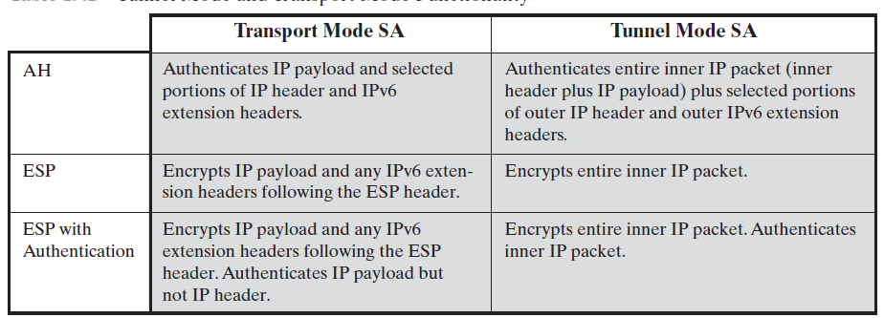
Transport & Tunnel Mode Functionality

Slide 99
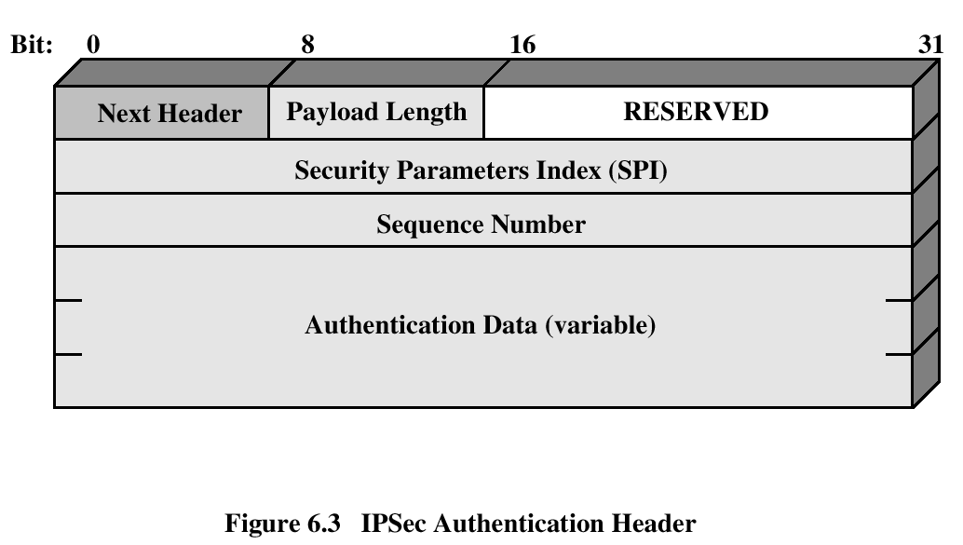
Authentication Header (AH)
The Authentication Header provides support for data integrity and authentication of IP packets.
Guards against replay attacks.

Slide 100
Authentication Header
The Authentication Header consists of the following fields
Next Header (8 bits):
Identifies the type of header immediately following this header.
Payload Length (8 bits):
Length of Authentication Header in 32-bit words, minus 2.
Reserved (16 bits):
For future use.
Security Parameters Index (32 bits):
Identifies a security association.
Sequence Number (32 bits):
A monotonically increasing counter value, discussed later.
Authentication Data (variable):
A variable-length field (must be an integral number of 32-bit words) that contains the Integrity Check Value (ICV), or MAC, for this packet, discussed later.

Slide 101
Authentication Header
Steps
An authentication header is added authentication data field set to zero.
Padding done to make the total length even for a particular hashing algorithm.
Hashing is based on the total packet, including only those fields of the IP Header which does not change.
Authentication data is inserted in the AH
IP header is added after the protocol is changed to 51

Slide 102
Authentication Header
Anti-Replay Service
A replay attack is one in which an attacker obtains a copy of an authenticated packet and later transmits it to the intended destination.
The receipt of duplicate, authenticated IP packets may disrupt service in some way or may have some other undesired consequence.
The Sequence Number field is designed to thwart such attacks.
When a new SA is established, the sender initializes a sequence number counter to 0.
Each time that a packet is sent on this SA, the sender increments the counter and places the value in the Sequence Number field.

Slide 103
Authentication Header
Integrity Check Value
The Authentication Data field holds a value referred to as the Integrity Check Value.
The ICV is a message authentication code or a truncated version of a code produced by a MAC algorithm.
The current specification dictates that a compliant implementation must support
HMAC-MD5-96
HMAC-SHA-1-96

Slide 104
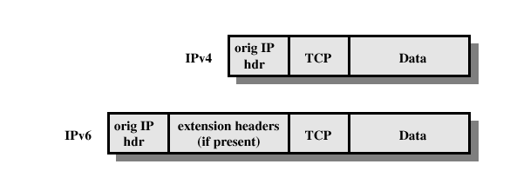
Authentication Header
Before Applying AH

Slide 105
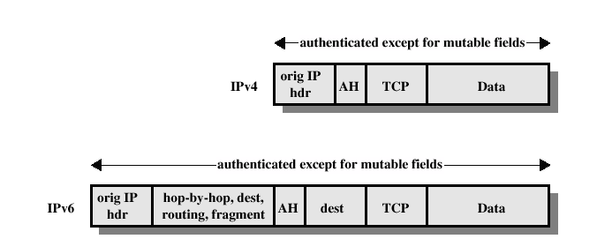
Authentication Header
Transport Mode (AH Authentication)

Slide 106
Authentication Header
For transport mode AH using IPv4, the AH is inserted after the original IP header and before the IP payload (e.g., a TCP segment).
Authentication covers the entire packet, excluding mutable fields in the IPv4 header that are set to zero for MAC calculation.

Slide 107
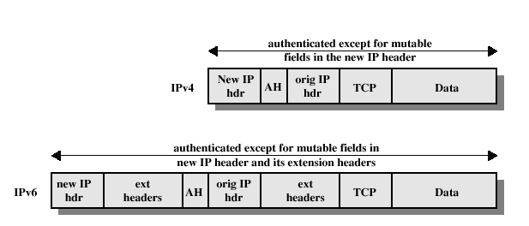
Authentication Header
Tunnel Mode (AH Authentication)

Slide 108
Authentication Header
For tunnel mode AH, the entire original IP packet is authenticated, and the AH is inserted between the original IP header and a new outer IP header.
With tunnel mode, the entire inner IP packet, including the entire inner IP header is protected by AH.
The outer IP header (and in the case of IPv6, the outer IP extension headers) is protected except for mutable and unpredictable fields.

Slide 109
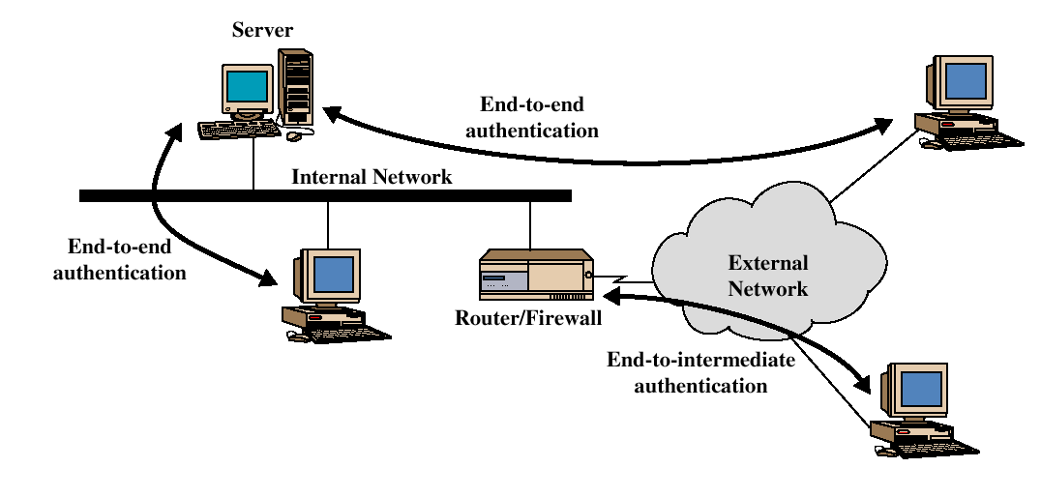
Authentication Header
End – to – End Versus End – to – Intermediate Authentication

Slide 110
Authentication Header
Two ways in which the IPSec authentication service can be used.
In one case, authentication is provided directly between a server and client workstations; the workstation can be either on the same network as the server or on an external network.
As long as the workstation and the server share a protected secret key, the authentication process is secure.
This case uses a transport mode SA.
In the other case, a remote workstation authenticates itself to the corporate firewall, either for access to the entire internal network or because the requested server does not support the authentication feature.
This case uses a tunnel mode SA.

Slide 111
Encapsulating Security Payload (ESP)
The Encapsulating Security Payload provides confidentiality services, including confidentiality of message contents and limited traffic flow confidentiality.
ESP can also provide an authentication service.

Slide 112
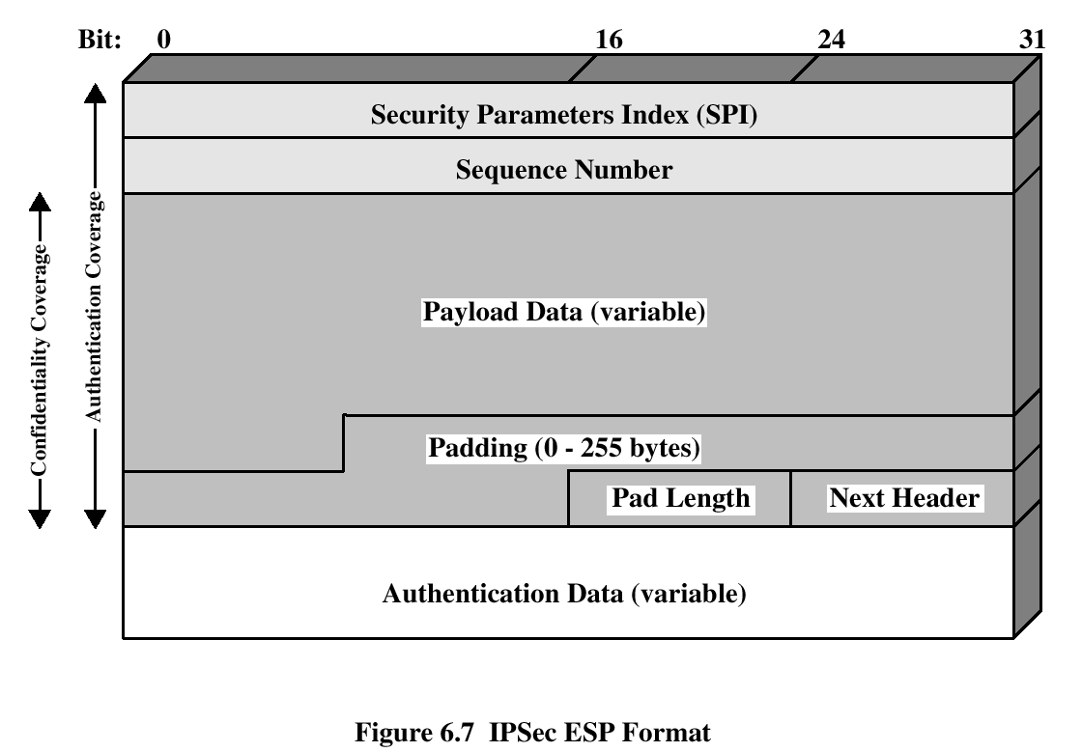
Encapsulating Security Payload

Slide 113
Encapsulating Security Payload
Security Parameters Index (32 bits):
Identifies a security association.
Sequence Number (32 bits):
A monotonically increasing counter value; this provides an anti-replay function, as discussed for AH.
Payload Data (variable):
This is a transport-level segment (transport mode) or IP packet (tunnel mode) that is protected by encryption.
Padding (0255 bytes):
The purpose of this field is discussed later.
Pad Length (8 bits):
Indicates the number of pad bytes immediately preceding this field.
Next Header (8 bits):
Identifies the type of data contained in the payload data field by identifying the first header in that payload.
Authentication Data (variable):
A variable-length field (must be an integral number of 32-bit words) that contains the Integrity Check Value computed over the ESP packet minus the Authentication Data field.

Slide 114
Encapsulating Security Payload
Encryption and Authentication Algorithms
The Payload Data, Padding, Pad Length, and Next Header fields are encrypted by the ESP service.
Three-key triple DES
RC5
IDEA
Three-key triple IDEA
CAST
Blowfish

Slide 115
Encapsulating Security Payload
Padding
The Padding field serves several purposes:
If an encryption algorithm requires the plaintext to be a multiple of some number of bytes the Padding field is used to expand the plaintext to the required length.
The ESP format requires that the Pad Length and Next Header fields be right aligned within a 32-bit word. Equivalently, the ciphertext must be an integer multiple of 32 bits. The Padding field is used to assure this alignment.
Additional padding may be added to provide partial traffic flow confidentiality by concealing the actual length of the payload.

Slide 116
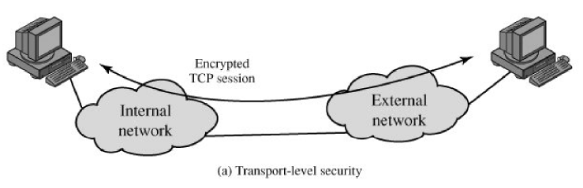
Encapsulating Security Payload
Transport Level Security

Slide 117
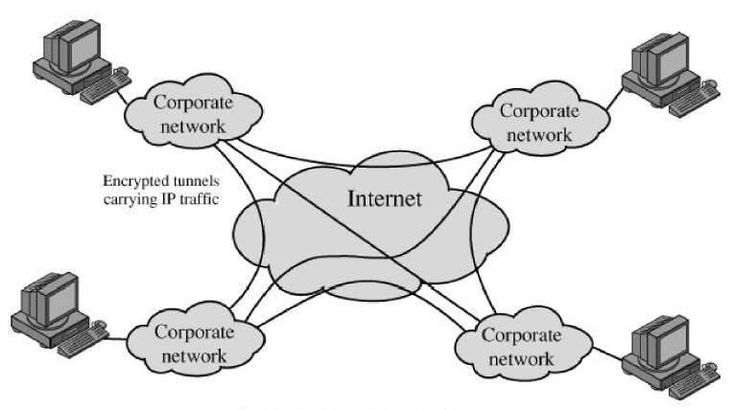
Encapsulating Security Payload
A Virtual Private Network via Tunnel Mode

Slide 118
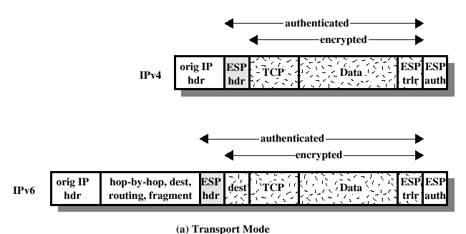
ESP Encryption & Authentication
Transport Mode

Slide 119
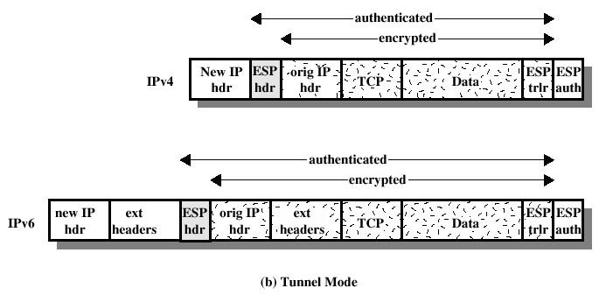
ESP Encryption & Authentication
Tunnel Mode

